Slide 1
INTRODUCTION TO RSTUDIO
JOSEPHINE MCKELVY

Slide 2

GOALS
Cover basic computing/programming concepts
Recap measurement & statistical concepts
Demonstrate relevant sociological data analysis, interpretation & visualization in R

Slide 3
OVERVIEW
Data Structures (and other terms)
Downloading RStudio & R
Parts of RStudio
Setting Directories
Importing & Cleaning Data
Analyzing Data
Factor Analysis
Correlation Matrices
Regression
Data Visualization
Tables
Plots

Slide 4
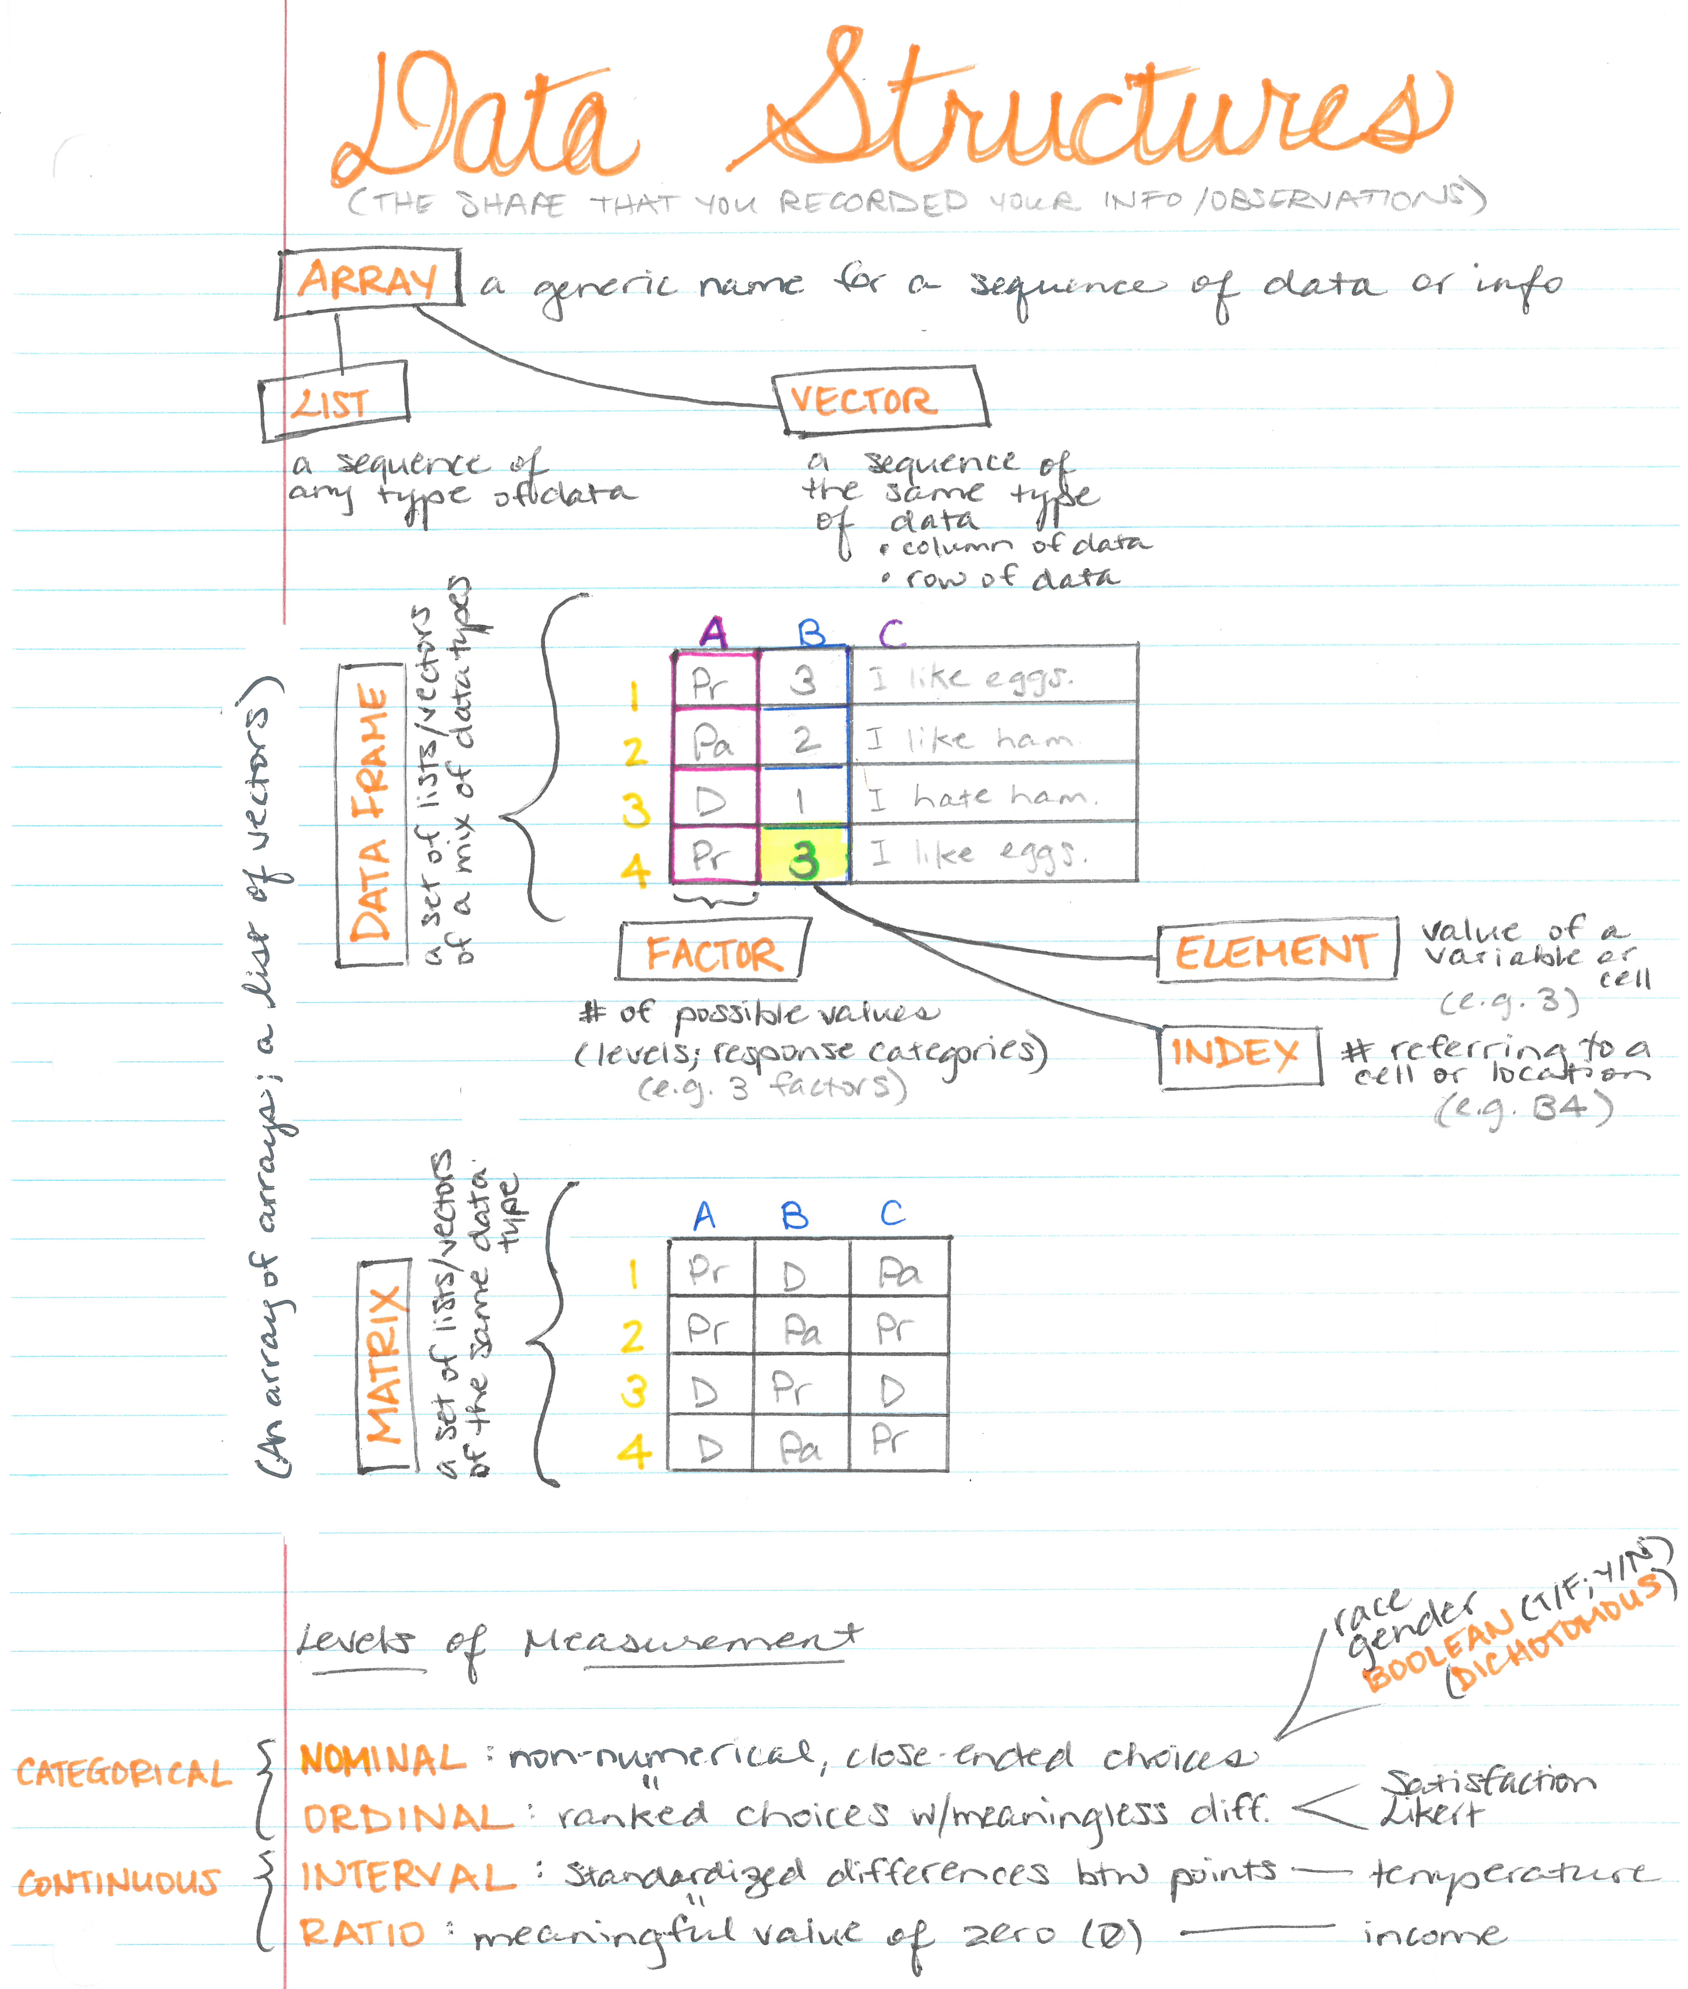
Notes:
Before we get into R, it will be helpful to know what “data structures” are: the shape of the information/observations that you recorded.
Arrays/lists/vectors: a series of values/numbers (stored in an array variable)
list: a series of different types of info
vector: a series of the same type of info (e.g., a variable or an observation/case)
index: location or reference to a data point or cell in the array
element: the value of a variable or cell
factor: the number of possible values, levels, or response categories of a variable
strings: arrays of written symbols (characters)
matrix: an array of arrays, 2-dimensional data, a list of lists (e.g., a dataset)

Slide 5

CRASH COURSE COMPUTER SCIENCE # 14: DATA STRUCTURES
Notes:
Here’s a 10-minute video too. (https://www.youtube.com/watch?v=DuDz6B4cqVc)

Slide 6
RECAP: OBJECTS
Data Structures
basic objects
lists: a set of varying kinds of data
vectors: a column or row of the same kind of data
derived objects
dataframe: a set of varying kinds of vectors
matrix: a set of the same kind of vectors
factor: categorical data with levels of responses

Slide 7
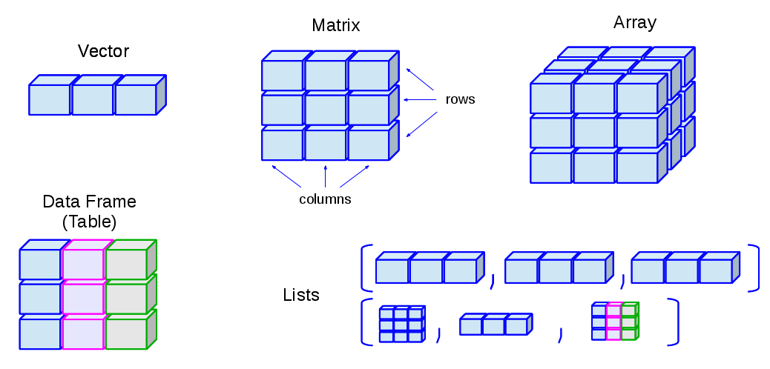
RECAP: OBJECTS

Slide 8
KINDS OF VECTORS
Data Types
Numerical: numbers
integer: positive/negative whole numbers
floating point: decimal numbers
Character: string of letters
words
Logical
Notes:
https://www.statmethods.net/input/datatypes.html

Slide 9
RECAP: KINDS OF DATA
Levels of Measurement
Nominal: close-ended, non-numeric response categories
Dummy/Dichotomous Variables: Y/N, T/F (boolean)
Race
Gender
factors in R
Ordinal: nominal variable with categories that are ranked, but the distance between the categories are meaningless
Likert-scale: 5-point scale from strongly disagree to strongly agree
Satisfaction levels
ordered factors in R
Value labels: the names for the categories

Slide 10
RECAP: KINDS OF DATA
Levels of Measurement
Interval: continuous variable with standardized distance between points
Temperature
Ratio: standardized, continuous variable with a meaningful zero-value
Income

Slide 11
GETTING STARTED
Download RStudio in the Software Center or: https://www.rstudio.com/products/rstudio/download/
It makes R easier to use.
When you open RStudio for the first time, it will prompt you to download R:
https://cran.r-project.org/bin/windows/base/
Just install the 64-bit. Windows 7 or later tend to be 64-bit and allows R to use more memory space.

Slide 12
PARTS OF RSTUDIO
THE PANES

Slide 13
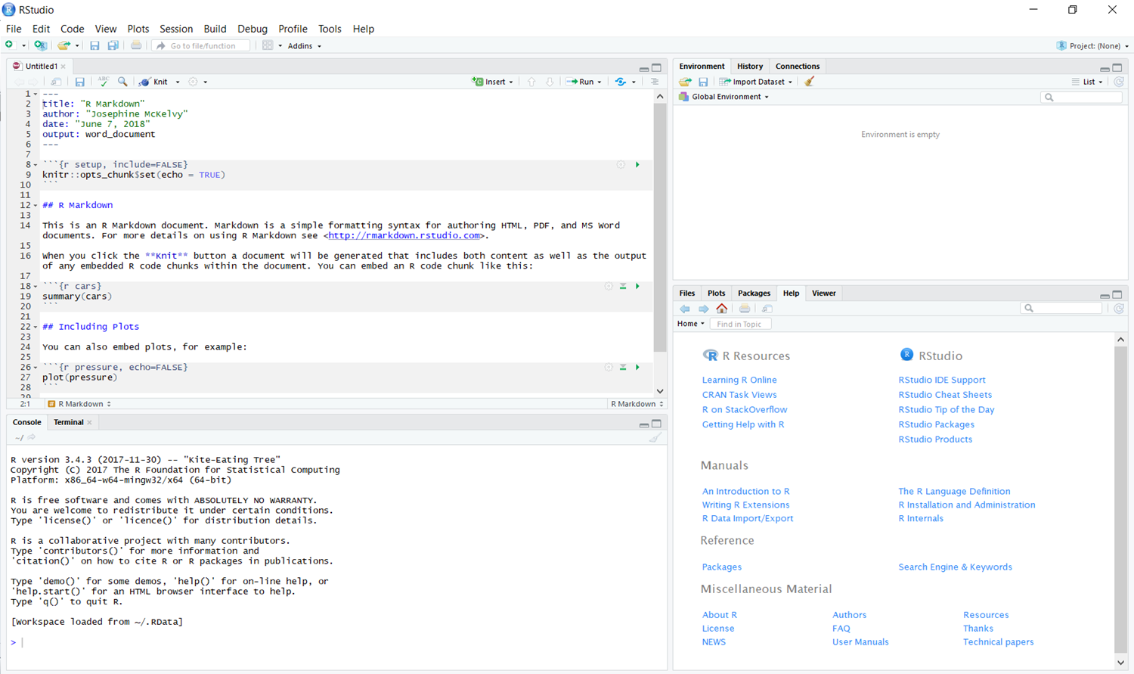
Source Editor: the pane where you should write and save your code/script

Slide 14
Console: the pane that shows the progress of the commands you’ve run
Notes:
The console is interactive—you can run your commands here—but it won’t be saved in your script for later use.

Slide 15
Environment/Workspace: the pane that shows (and temporarily stores) the data & objects you’ve created

Slide 16
Viewer: the pane with the resources & everything else

Slide 17
CODING

Slide 18
SOURCE FILE
Create a new file or open a saved file.
R Script: the code that you will run to conduct your analysis
R Markdown: exports your script and output to a *.pdf or *.doc

Slide 19
COMPUTING TERMS
function calls: commands, tasks, or actions you can do to the data that returns a value (e.g., summarize, regress, plot, etc.)
function(data, arguments)
assignment: storing the results of a function to a specific object
OBJECT <- mean(x)
OBJECT = mean(x)
packages: a set of compiled code to run certain commands
You only need to download/install a package once.
But you have to attach/load the package(s) into each session when you use them.
library: directory where the package is stored
code/script: a savable set of commands you’ll run
Notes:
http://www.burns-stat.com/documents/tutorials/impatient-r/

Slide 20
HOT KEYS
ALT + minus to create <-
This assigns (or stores) whatever functions you want to run to an object that you can name:
OBJECT <- function (data, arguments)
CTRL + ENTER to run selected lines of script
# to include documentation (or reminders about what your code does) that do not compile
Type the first 3 letters of a function or object and RStudio will show autocomplete options.
$ indicates a subset:
DATASET$VARIABLES
DATAFRAME$VECTOR
Notes:
Anything I put in ALL CAPS is an object that you can name whatever you want.

Slide 21
CODING CONVENTIONS
R is case-sensitive.
Names need to start with a character (no numbers or symbols)
= assigns a value to an object
== identifies cases where two elements (like an index and a value) are equal (e.g., if the ID# is 7, ID == 7)
& means and
| means or
Notes:
http://www.burns-stat.com/documents/tutorials/impatient-r/

Slide 22
SET A DIRECTORY

Slide 23
SET A DIRECTORY
Create a folder where RStudio will import your data and save your plots.
Set this folder as your working directory by inserting the filepath in the quotes.
setwd(“LOCAL FILEPATH”)
Notes:
If you’re like me, you’re working from a home computer, office computer, and laptop. That’s three local directories with three copies of your dataset(s), three R files--and plenty of room for confusion if you’re saving all of your changes.

Slide 24
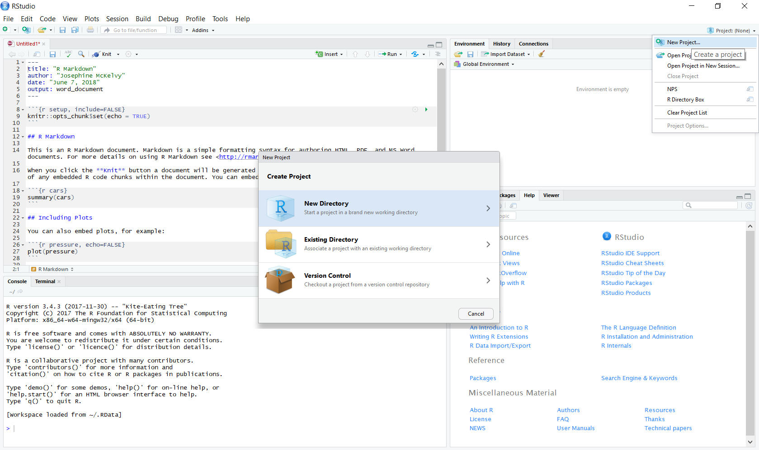
OR start a new project in a new working directory. You can set this directory to be a folder in a cloud storage service instead of a local folder, trapped on your machine.
Here are some projects I created.
Notes:
Each project will save and automatically load your files and environment.

Slide 25
VERSION CONTROL

Slide 26
IMPORT DATASET

Slide 27
IMPORT DATASET
If you don’t have this package (or set of compiled code), install it before using it for the first time.
Then you can load this library (or directory where the package is stored) and call the functions in it. You’ll have to load the library for each session you start.
install.packages(“qualtRics”)
library(qualtRics)
Notes:
http://gss.norc.org/Get-The-Data

Slide 28
MISSING DATA
Make sure the dataset is in your directory folder.
Read in the data with the “readSurvey” function in the “qualtRics” library.
Replace missing values with “99” or whatever symbol you’re using to indicate missing data.
RAWDATA.DF <- readSurvey(“NAME OF DATASET.csv”, na.strings = “99”)
Or do this after you read in the data:
RAWDATA.DF[RAWDATA.DF=="."] <- NA #if a period denotes missing data
Or do this on a variable-by-variable basis:
RAWDATA.DF$VARIABLE1[RAWDATA.DF$VARIABLE1=="."] <- NA #if a period denotes missing data
RAWDATA.DF$VARIABLE2[RAWDATA.DF$VARIABLE2==" "] <- NA #if a space denotes missing data
RAWDATA.DF$VARIABLE3[RAWDATA.DF$VARIABLE3==99] <- NA #if a value denotes missing data

Slide 29
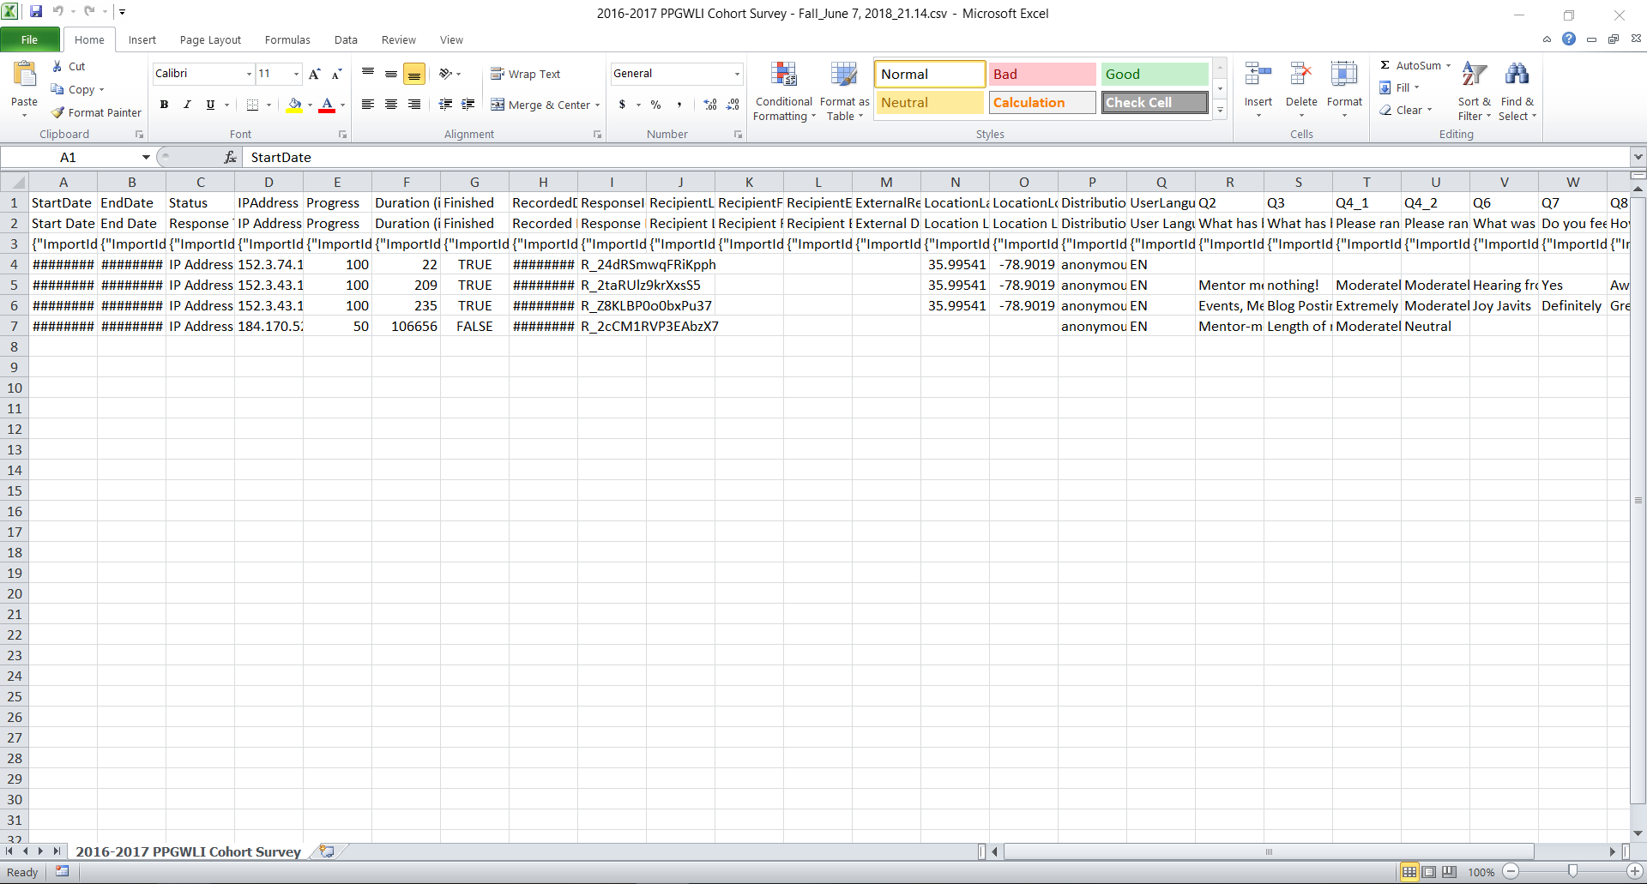
QUALTRICS RESPONSES
Notes:
Why use qualtRics::readSurvey?
There are THREE header rows before you even get to the data!
The readSurvey function in the qualtRics library will ignore those headers instead of reading them as data.

Slide 30
NOT USING QUALTRICS?
**1-based index**: R starts with the first row of obs. being "1";
3:nrow means that your responses/obs. start on row 4 until the Nth row.
Check your dataset to see which row the actual observations start.
newdata.df <- rawdata.df[3:nrow(rawdata.df),] #Confirm the number of obs. and variables

Slide 31
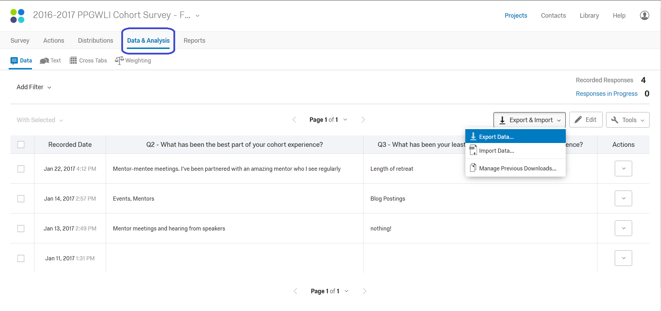
EXPORTING DATA FROM QUALTRICS
Notes:
In case you don’t know how to export data from Qualtrics, here are the tabs & buttons.
But qualtRics::readSurvey will read in any *.csv file with headers.
Just make sure that your A1 cell is NOT “ID” in your *.csv file. This will make Excel think you have a *.sylk file and pop up error messages about invalid file formats. http://www.recovery-tools.org/techtalk/fix-sylk-file-format-is-not-valid.html

Slide 32
STATA
library(haven)
RAWSTATA <- read_dta("GSS.dta")
Notes:
Created and downloaded GSS extracts for Stata (http://gss.norc.org/Get-The-Data), extracted *.dta file, saved to directory folder
Load the haven library, run the read_dta function

Slide 33
CLEAN THE DATA

Slide 34
DROPPING CASES, cont.
Create an analytic dataframe (DATA.DF) where listwise deletion removes cases with missing data:
DATA.DF <- na.omit(RAWDATA.DF)
Drop certain cases (e.g., case number 7):
DATA.DF <- DATA.DF[!DATA.DF$IDENTIFER==“7”,]

Slide 35
CREATING FACTORS
Cut a continuous variable into nominal categories:
DATA.DF$VARIABLE <- cut(DATA.DF$VARIABLE, c(0,6,8,10))
# This means that values 0-6 is one category, 7-8 is another category, and 9-10 is the third category.
Set levels of responses & label the response values for a factor (ordinal variable):
DATA.DF$VARIABLE = factor(DATA.DF$VARIABLE, levels = c(1,2,3,4,5), labels = c("Strongly Disagree", "Disagree", "Neither", "Agree", "Strongly Agree"), ordered = TRUE)
Name the variables:
names(DATA.DF) <- c(“Variable name”, “Likert-scale Item”, “Column Header”)
Notes:
I would suggest creating these factors for the raw(er) dataset before subsetting the dataset into smaller datasets (for analysis) to avoid repetition.

Slide 36
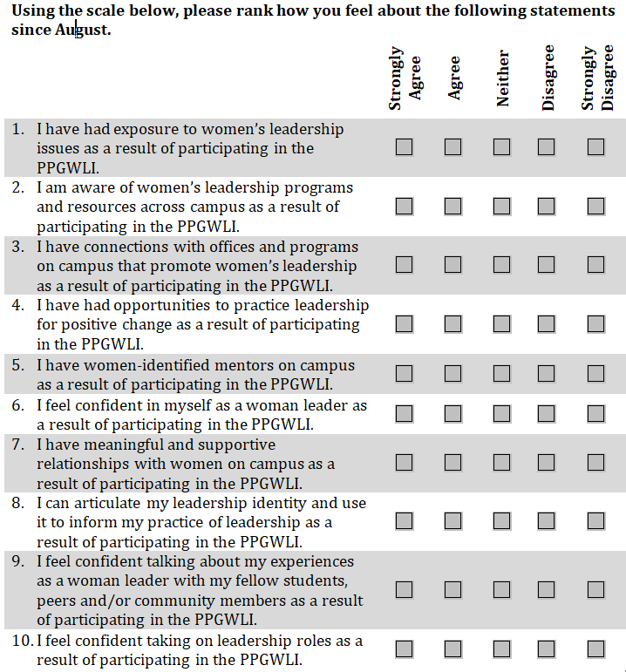
names or levels for each choice
5 possible choices or levels
10 variables

Slide 37
SUBSET THE DATA
#keep if a specific variable, VARIABLE, is not missing a value:
DATA1.DF <- subset(DATA.DF, !is.na(VARIABLE))
#keep certain columns only (e.g., keep columns 1 through 12):
DATA2.DF <- DATA.DF[,1:12]
#keep if a variable is one of two values (e.g., if the value for the variable time.point is either fall or spring):
DATA3.DF <- subset(DATA.DF,time.point=="Fall"| time.point=="Spring")
#keep certain columns if a variable is a certain value (e.g., keep columns 3 to 12 if the value for the variable time.point is spring):
DATA4.DF <- subset(DATA.DF, time.point=="Spring", select = 3:12)

Slide 38
PRINCIPAL COMPONENTS ANALYSIS

Slide 39
PRINICIPAL COMPONENTS
What are some distinct, uncorrelated variables (i.e., principal components) in a set of survey items with a similar scale (e.g., 5-point Likert-scale items) that accounts for the variability in the data?
Principal Components Analysis (PCA):
OBJECT <- princomp(DATA, cor = TRUE)
Summary(OBJECT) #r-square values for each component
Loadings (OBJECT) # principal components loadings or scores
Notes:
ftp://statgen.ncsu.edu/pub/thorne/molevoclass/AtchleyOct19.pdf (definitions)
https://statistics.laerd.com/spss-tutorials/principal-components-analysis-pca-using-spss-statistics.php (conditions to run PCA)
https://www.statmethods.net/advstats/factor.html (R code)
https://stats.stackexchange.com/questions/144508/conclusions-from-output-of-a-principal-component-analysis (interpreting results from a PCA)

Slide 40
PRINICIPAL COMPONENTS
interpretation
Notes:
asdf

Slide 41
CORRELATION COEFFICIENTS

Slide 42
CORRELATION
What kind of (linear) relationship exists between two continuous variables? Are they changing together?
Pearson’s product moment correlation coefficient:
cor(DATA$VARIABLE1, DATA$VARIABLE2)
Notes:
http://support.minitab.com/en-us/minitab-express/1/help-and-how-to/modeling-statistics/regression/supporting-topics/basics/a-comparison-of-the-pearson-and-spearman-correlation-methods/

Slide 43
CORRELATION
What kind of (nonlinear) relationship exists between two continuous or categorical variables? Are they changing together?
Spearman’s rank-order correlation coefficient:
cor(DATA$VARIABLE1, DATA$VARIABLE2, method = “spearman”)

Slide 44
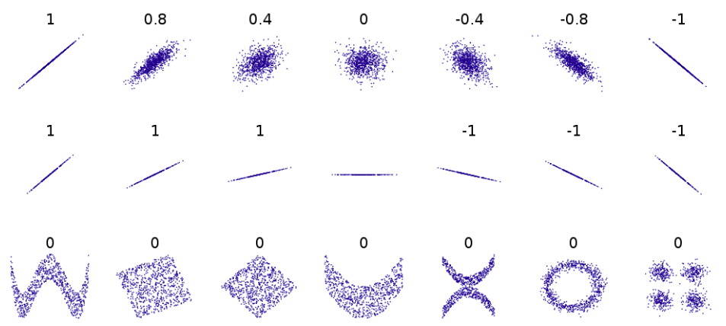
CORRELATION
Correlation Coefficient:
Direction
positive coefficient: both variables go in the same direction
negative coefficient: as 1 variable increases, the other variable decreases
Strength
value close to 1: strong association
value close to 0: weak association
Notes:
https://dzchilds.github.io/eda-for-bio/relationships-between-two-variables.html

Slide 45
TABLES

Slide 46
TABLES
basic descriptive statistics and frequencies:
summary(VARIABLE) # min, max, quartiles, mean, missing
table(DATA$VARIABLE) # counts for each response category
2-way crosstabs for continuous data:
TABLE2<- table(DATA$VARIABLE,DATA$VARIABLE) # just the counts
round(prop.table(TABLE2),2) # row & column proportions, rounded to 2 digits
3-way crosstabs for continuous data:
TABLE3 <- xtable(DATA$VARIABLE, DATA$VARIABLE, DATA$VARIABLE) # haven’t tested this one
2-way crosstabs for categorical data:
CrossTable(DATA$VARIABLE,DATA$VARIABLE, digits = 2, chisq = TRUE) # haven’t tested this one
Notes:
https://www.princeton.edu/~otorres/sessions/s2r.pdf

Slide 47
TABLES
The kable function in the knitr library generates publication-ready tables:
knitr::kable(TABLE2, digits = 2) #up to 2 decimal places # you may have to install the knitr library.

Slide 48
ANALYSES & PLOTS

Slide 49
TYPES OF ANALYSES
Likert-scale items
Survey
Data
Plot
Hypothesis Testing
Regression
OLS Regression Models

Slide 50
Notes:
This is the survey.

Slide 51
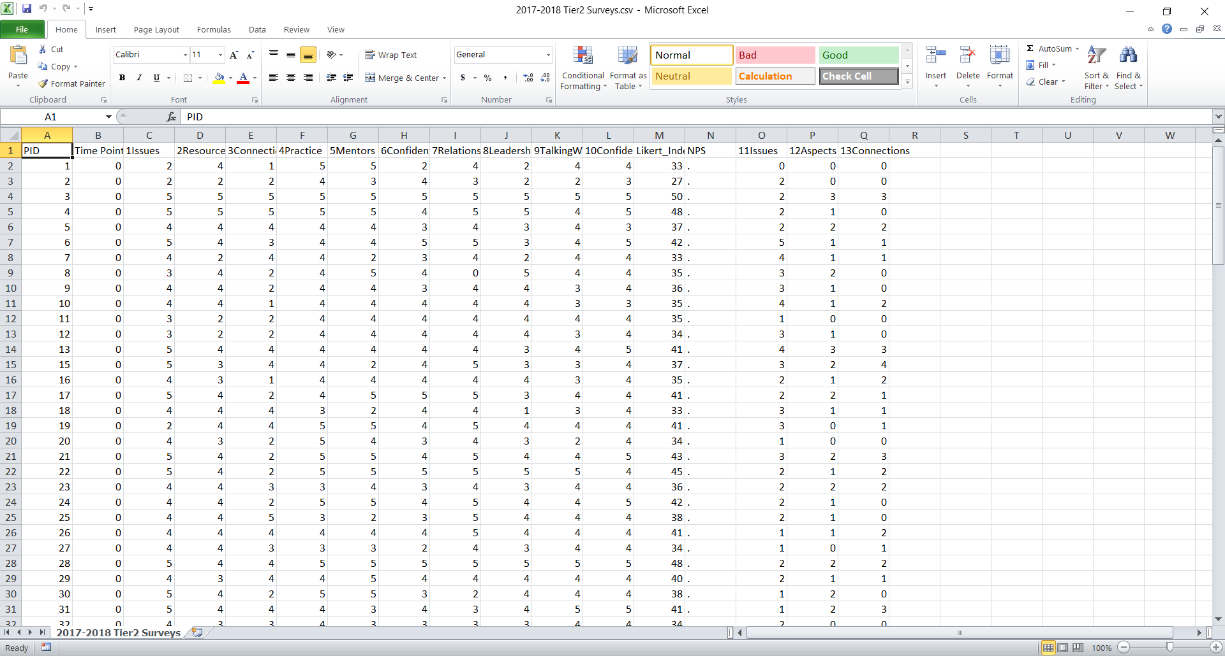
Notes:
This is the raw data entered into Excel.

Slide 52
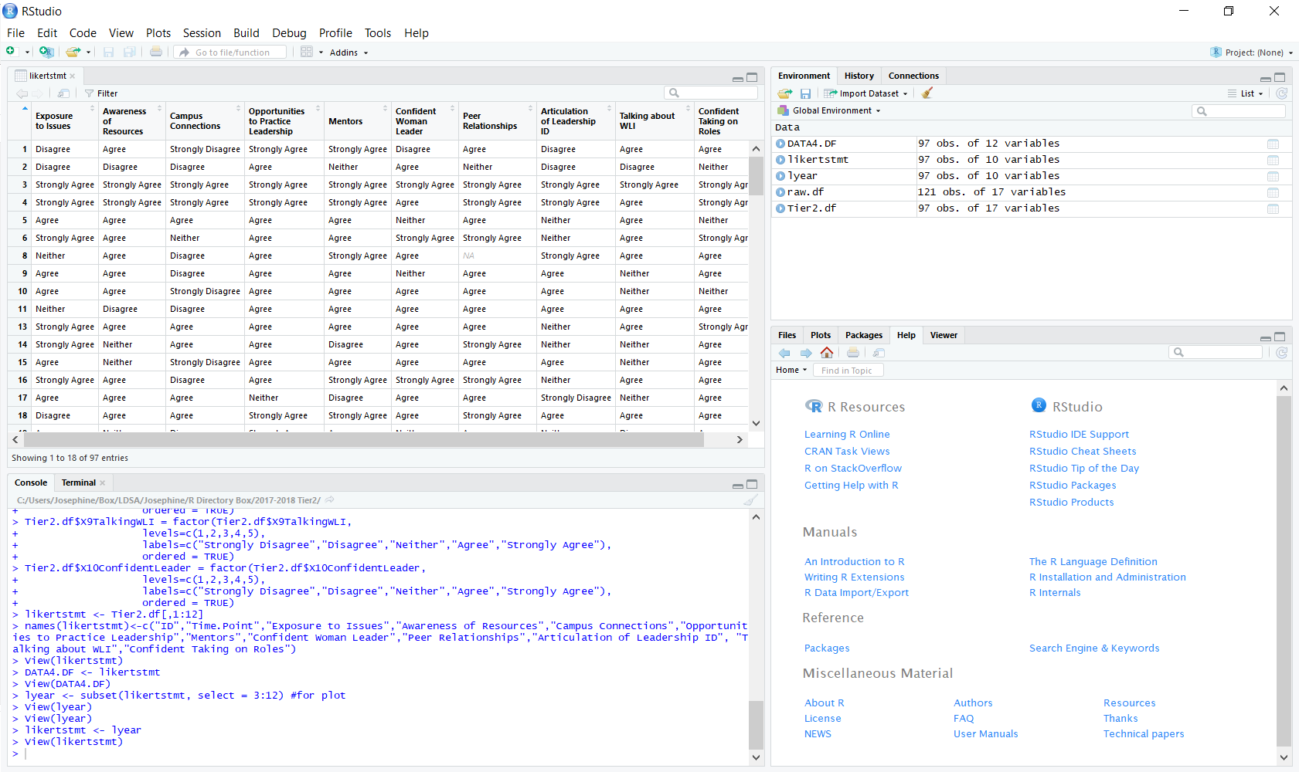
Notes:
You can click on the clean, analytic dataset (with factors, and just the Likert-scale items) in the Environment pane to view its contents.

Slide 53
LIKERT-SCALE ITEMS
install.packages(“likert”)
library(likert)
ANALYSIS1 <- likert (LIKERTSTMT [,1:10] grouping = DATA.DF$TIME.POINT, nlevels = length(levels(LIKERTSTMT[,1]))) #create an object, ANALYSIS1, that holds the summary table of the Likert function on columns 1 to 10 of the subsetted data (LIKERTSTMT) #organize/group the Likert-scale items by the variable, TIME.POINT in the original dataset #makes sure that all variables have the same number of levels, even if there are some levels with no responses
plot(ANALYSIS1, type = “bar”, positive.order = TRUE, group.order = c(‘Fall’, ‘Winter’, ‘Spring)) + ggtitle(paste(“Chart of Likert Statements, over Time”))
guide = guide_legend(reverse = TRUE) #reverses the order of the responses in the legend
ggsave(“FILENAME.png”, width = 8, height = 8, units = “in”) #saves the image to your directory
Notes:
This is the script with the packages, library, functions, plots.

Slide 54
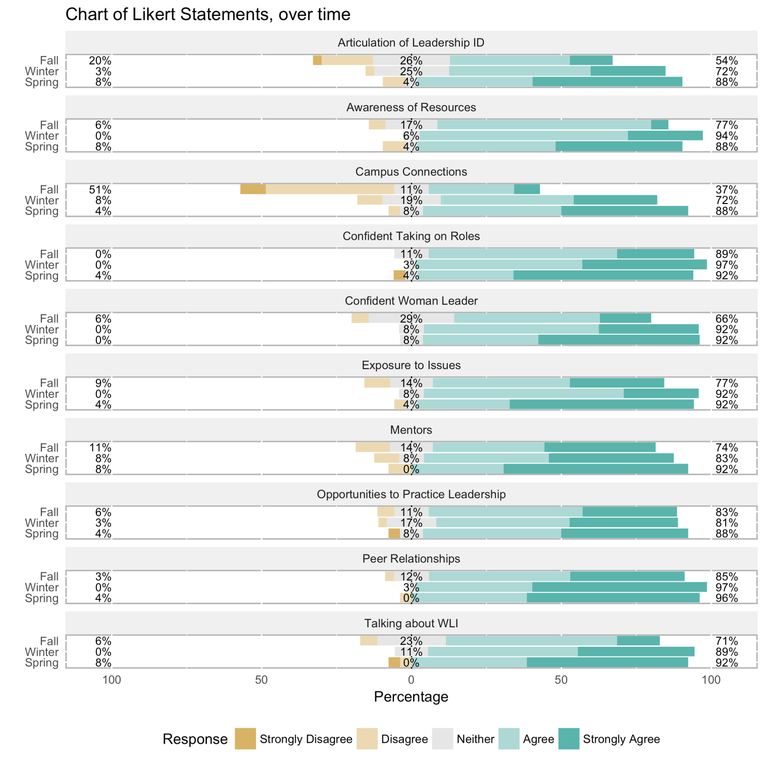
Notes:
This is the plot saved in the directory.
With diverging bar charts, you can quickly compare responses across groups (in this case, 3 time points).

Slide 55
HYPOTHESIS TESTING
You can see the substantive differences in the chart, but did they happen because of your intervention, or by happenstance?
Chi square tests for continuous data:
Fisher’s exact tests for smaller samples:

Slide 56
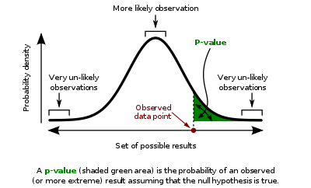
HYPOTHESIS TESTING
A p-value of 0.05 or lower means that there is a less than 5% probability that these findings happened by chance (with or without your intervention); which is good!
This is the standard threshold.
Any p-value higher than 0.05 means that your findings are not statistically significant.

Slide 57
REGRESSION
What kind of equation best describes, models, or specifies the relationship between variables?
Types | Dependent Variable | Independent Variable | Relationship
Ordinary Least Squares (OLS) Regression | continuous | any type | linear
Stepwise Regression | continuous | any type | add/remove variables with each model
Logistic Regression | dichotomous | any type | non/linear
Ordinal Logistic Regression | ordinal | any type
Poisson Regression | count data | any type
Notes:
http://support.minitab.com/en-us/minitab-express/1/help-and-how-to/modeling-statistics/regression/supporting-topics/basics/types-of-regression-analyses/
https://www.analyticsvidhya.com/blog/2015/08/comprehensive-guide-regression/
http://statisticsbyjim.com/regression/choosing-regression-analysis/

Slide 58
OLS REGRESSION
lm(Y~X1+X2)

Slide 59
OLS REGRESSION
interpretation

Slide 60
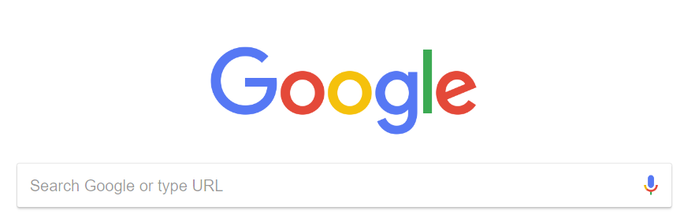
R-Bloggers
R Pubs
StackOverflow
rfun.library.duke.edu
Notes:
When all else fails, Google it!

Slide 61


